Slide 1

OPERATING SYSTEM
LAB ASSIGNMENT - 2
BASH Script snippets and explanations
GROUP MEMBERS:
1.Mitta Lekhana Reddy - IIT2019204
2.Sanskar Patro - IIT2019205
3.Dhanush Vasa - IIT2019208
4.Gitika Yadav - IIT2019219
5.Pravallika Kodi - IIT2019234

Slide 2
Question 2F:
Write a SHELL Script which takes a source pathname/filename and a destination
pathname from the user, checks whether the source file and the destination pathname
(directory) exists. If not, prompts to the user to correctly provide the inputs. When it
receives correct inputs, asks the user to input values for a delimiter and a field-number. It
then executes your mycut command with the -d and -f options with the specified values
of delimiter and field-number on the input file. The output of the execution is not
displayed on the terminal; rather, it is redirected to a newly created file called output
which is placed in the destination directory as mentioned by the user.

Slide 3
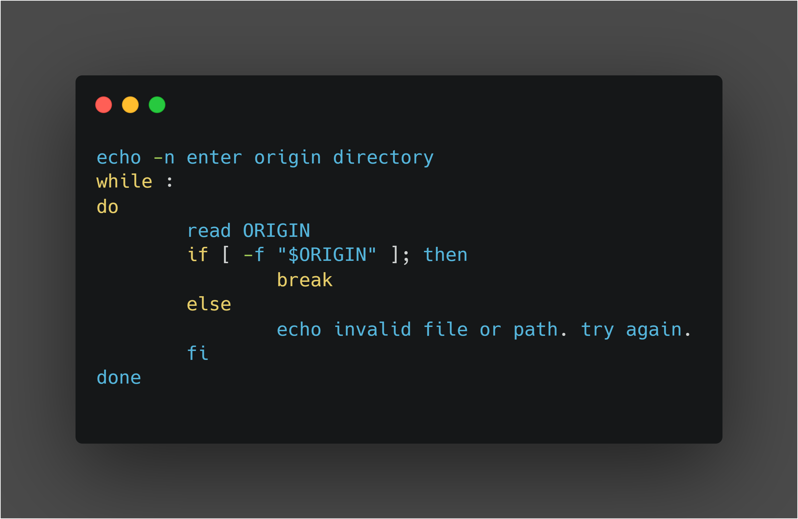
Origin pathname/filename input

Slide 4
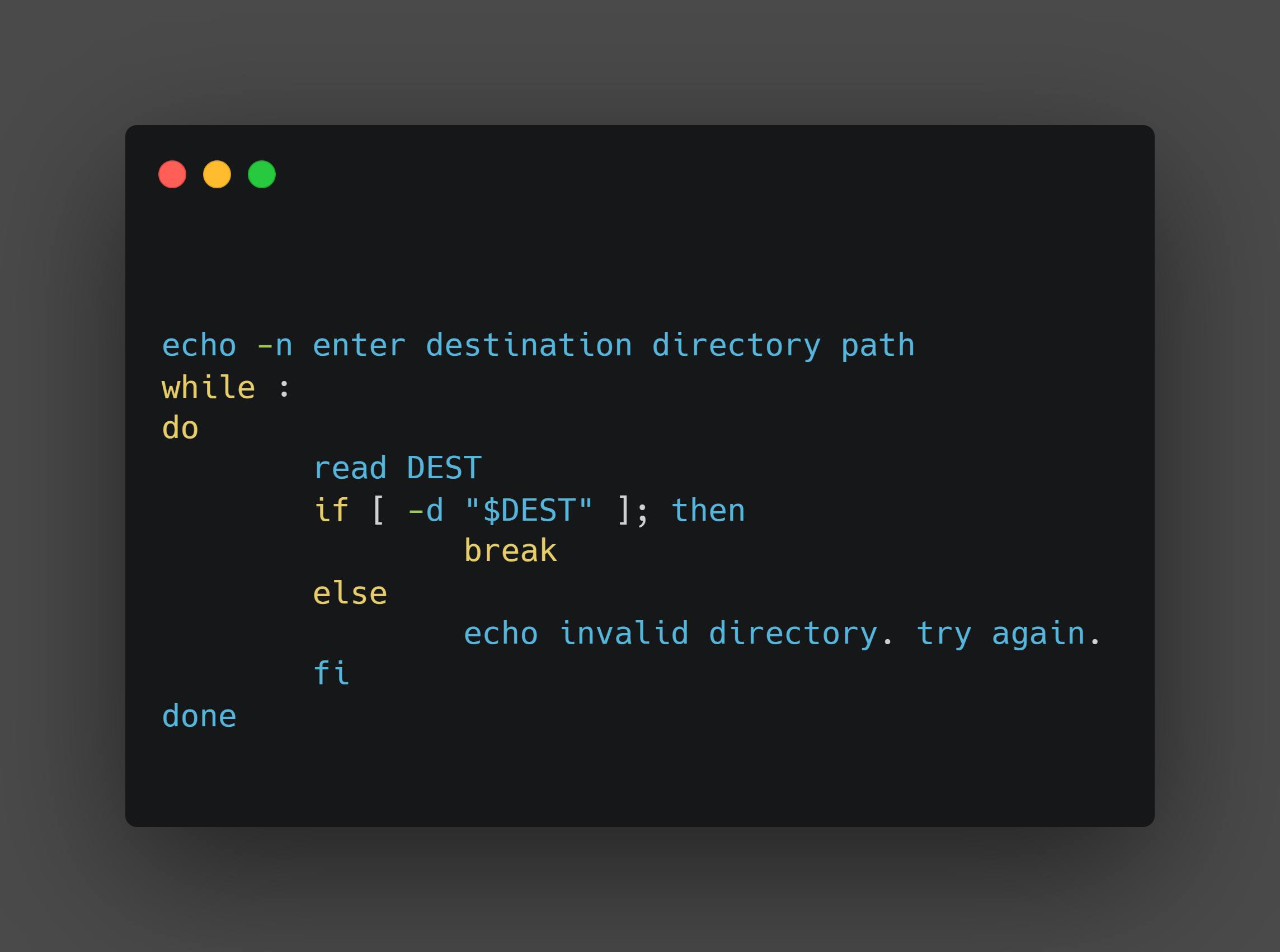
Destination path input

Slide 5
What’s happening in slides 3 and 4:
** When the user inputs origin directory path and destination directory
path the do-while loop along with if else condition is executed to check the
existence / validity of the given origin and destination directory paths .
**If the given input origin directory path exists and is a regular file, we exit the loop.
If the destination directory exists, we exit the loop.
**Else displays “ invalid path or file. try again “

Slide 6
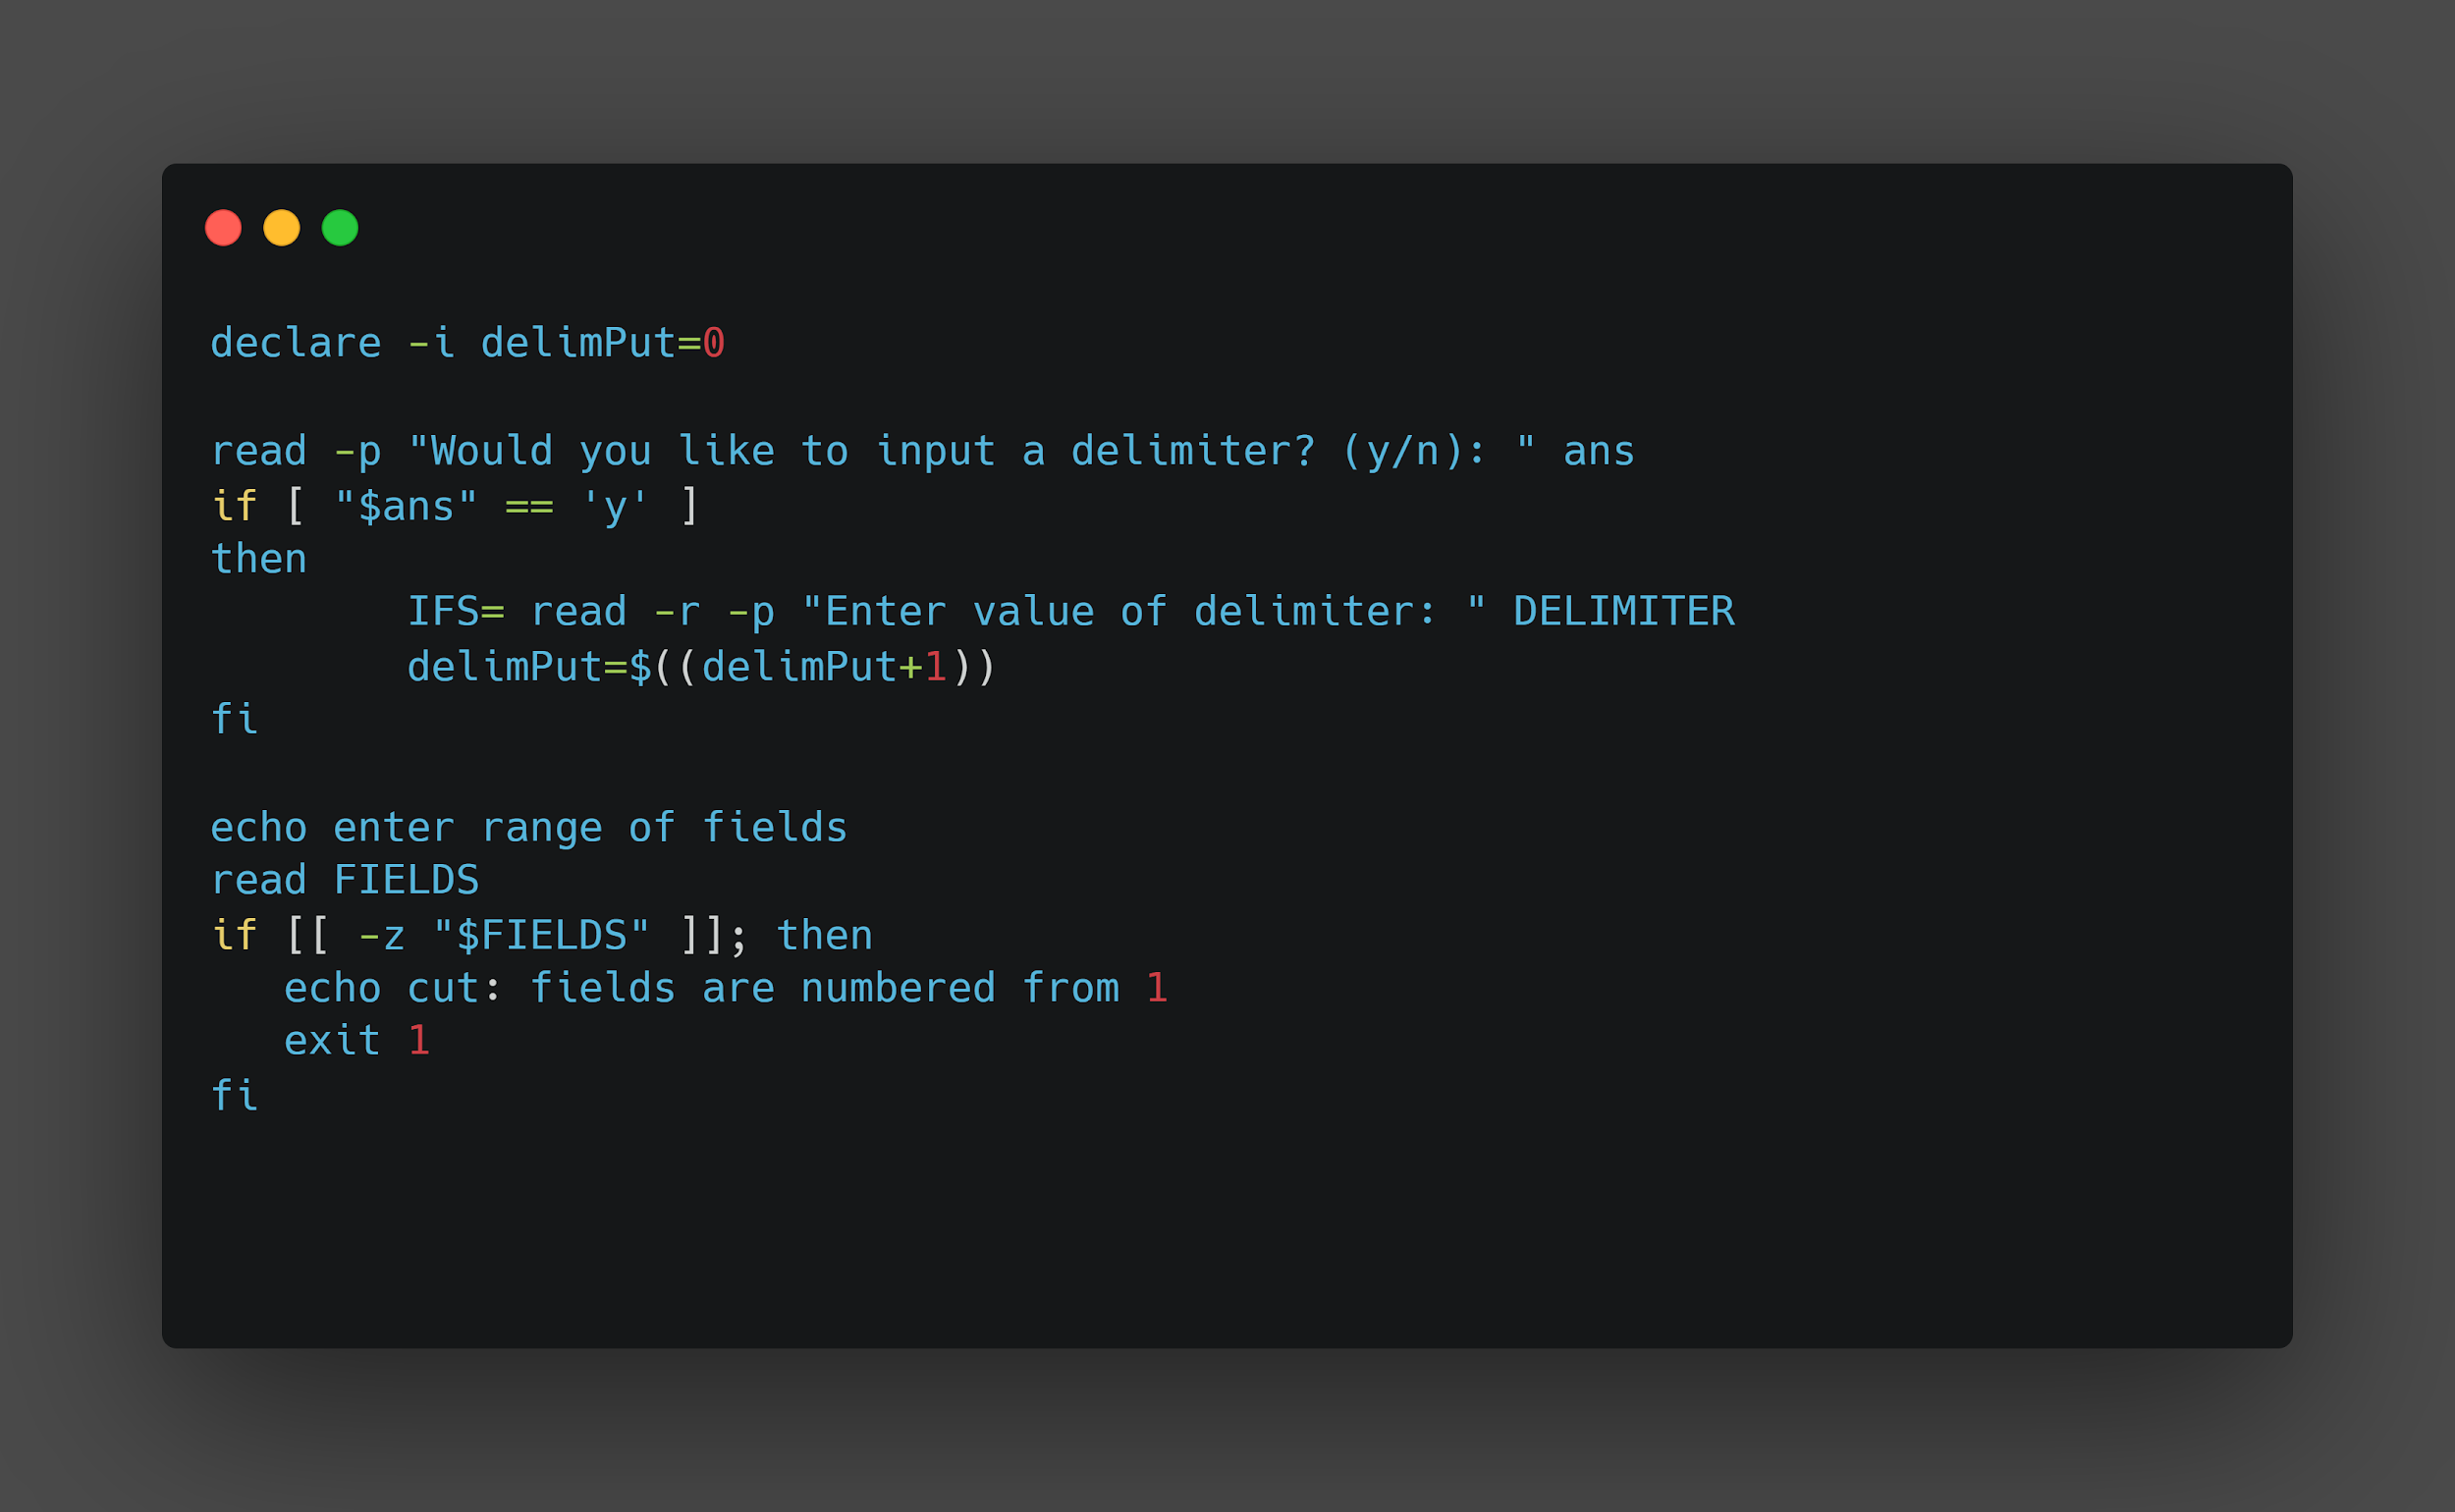
Asking user if they want to input a delimiter

Slide 7
Explanation of slide 6:
** delimPut is a variable initialized as 0.
**The statement “would you like to input a delimiter ?(y / n):” is
displayed and the answer given by the user is stored in a variable “ ans “ .
**If ans = ‘y’,it asks the user to input delimiter value which is stored in variable “DELIMITER” and the value of “DELIMITER” is assigned to INTERNAL FIELD SEPARATOR. This prevents the terminal from removing any leading or trailing whitespaces.
**And then the value of delimPut is updated by 1.

Slide 8
Explanation of slide 6:
**Display the message “ enter range of fields“ .
** The user now inputs the range of fields and stores the range of
fields in variable “FIELDS”
**If the input is of length 0 then display the message
“ cut : fields are numbered from 1 “

Slide 9
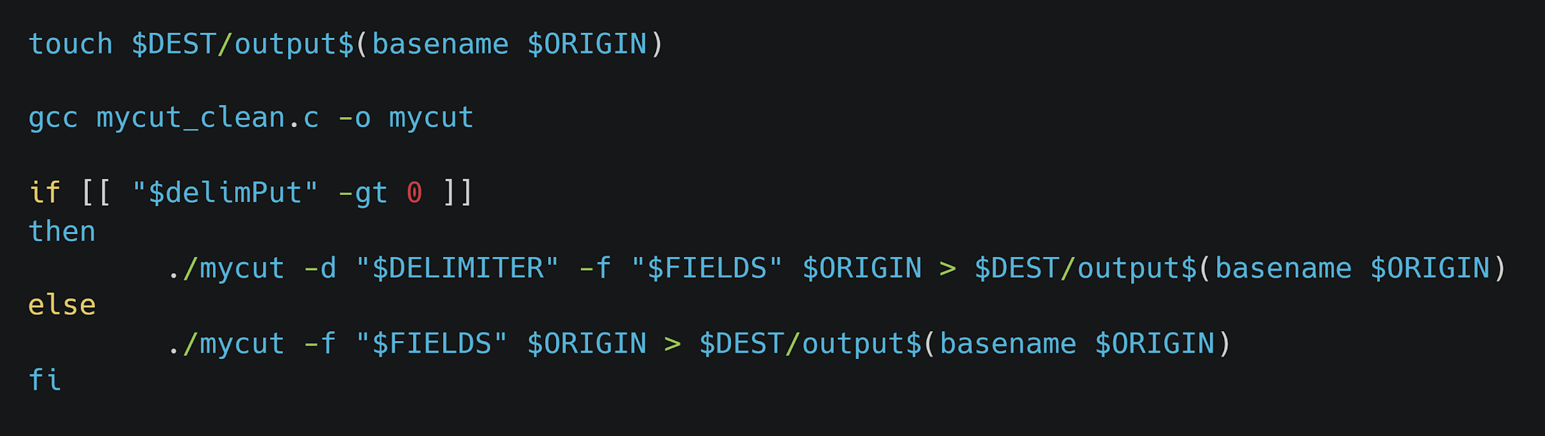
Making output file and running code.

Slide 10
Explanation for slide 9:
A file “output_filename“ will be created in the destination directory using touch command. Basename has been used to get the filename from the path
Now, we check the value of delimPut which signifies if the user has input a delimiter or not. If the value is 0 (user has chosen not to input delimiter), we run our C program without giving delimiter in the command line arguments.
Else if the value of delimPut is 1 (user has chosen to input delimiter), we run the C program and mention the value of delimiter in the command line.

Slide 11
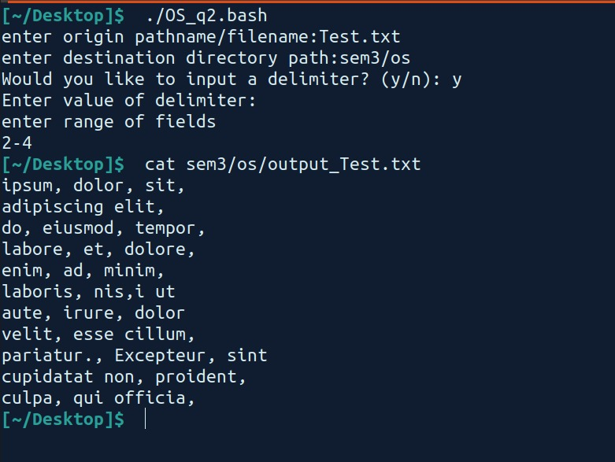
Example - 1

Slide 12
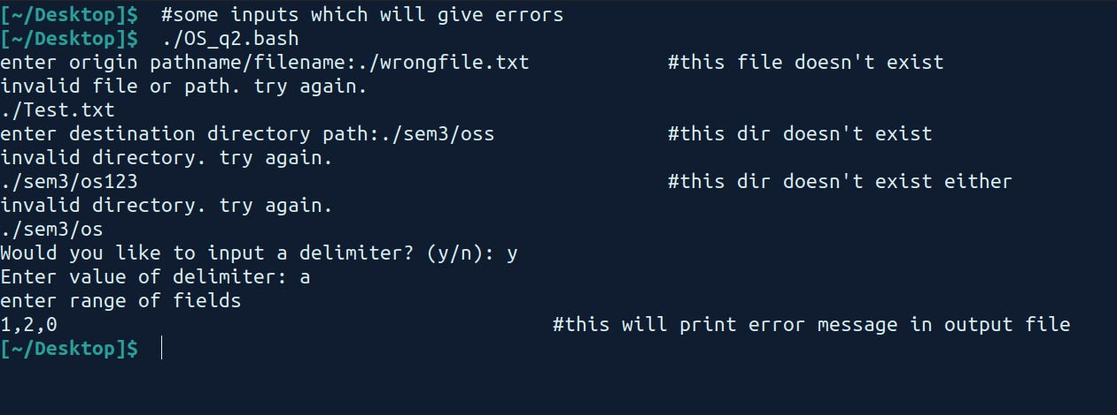
Example - 2

